Slide 1
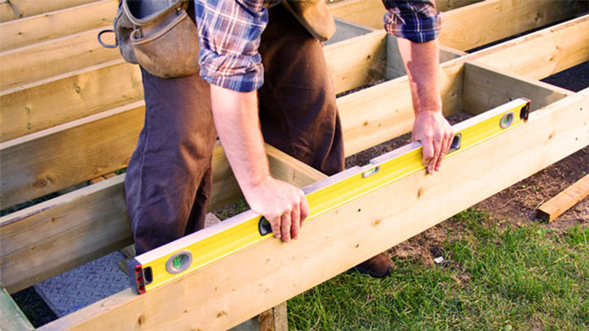
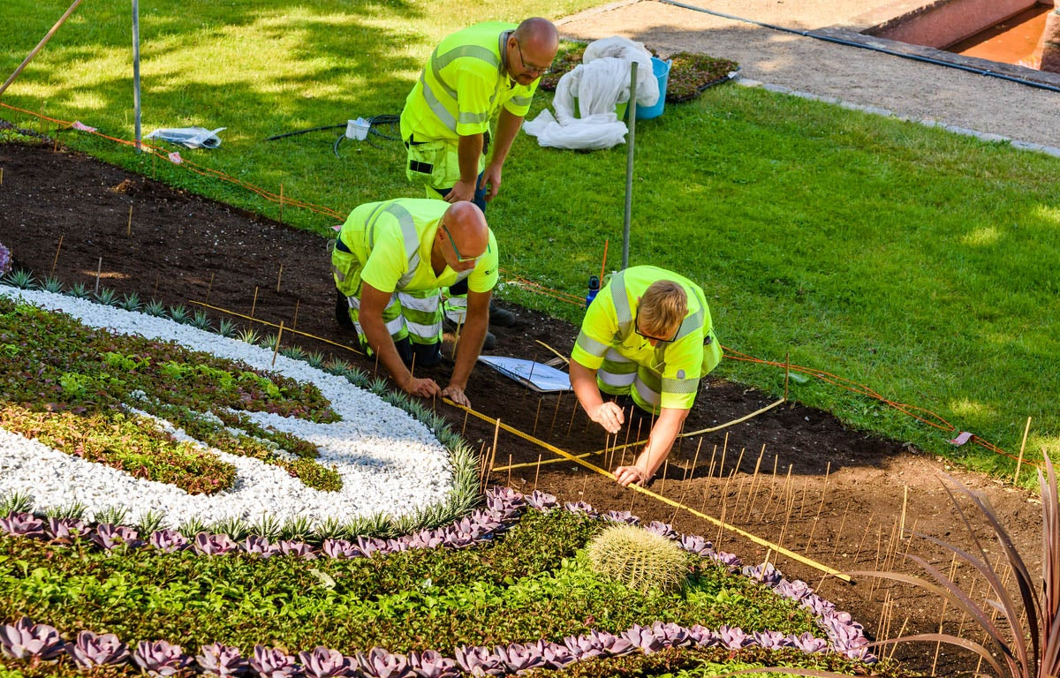
Pay for Performance, Integrated with Aspire
Link quality & production to crew-based incentives
For Contractors by Contractors
protiv.com 877-57-PROTIV

Slide 2
Directly link what your landscaping crews gets done, to what they get paid
Pay for Performance Improves:
Quality & Production
Communication & Teamwork
Protiv is integrated to Aspire, providing you a turn-key performance pay solution. Implement in as little as one day!
Works for commercial and residential route-based maintenance and design-build projects
11.5%
Labor Savings
21%
Increased Production
10.5%
Increased Avg Wages
Increased quality, better teamwork and workers love it!
13

