Slide 1
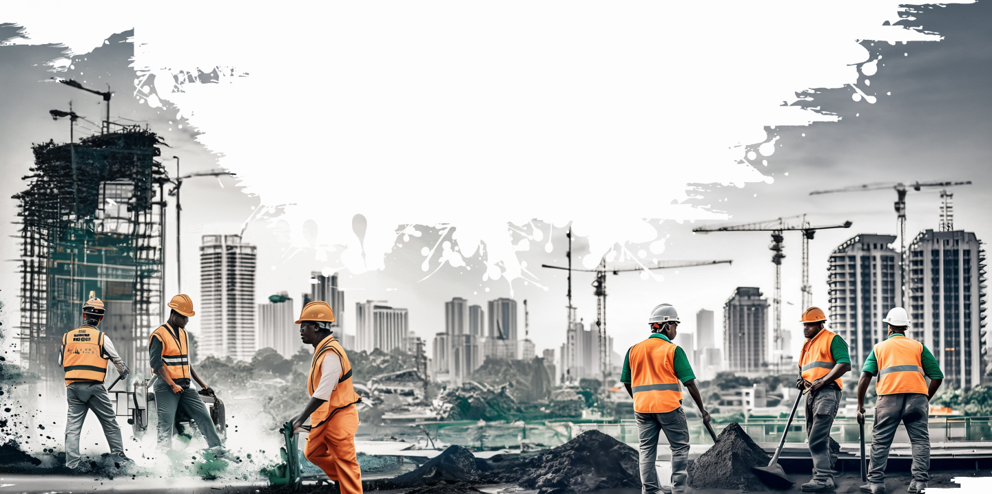
The Foundations of a Strong
Company Culture
For Contractors and Trade Business Leaders

Slide 2
What We’ll Cover
01
What Culture Is & Why It’s Critical To
Business Growth for Contractors
The Four Foundations of Strong Company Culture
for Trade Business Leaders
02

Slide 3
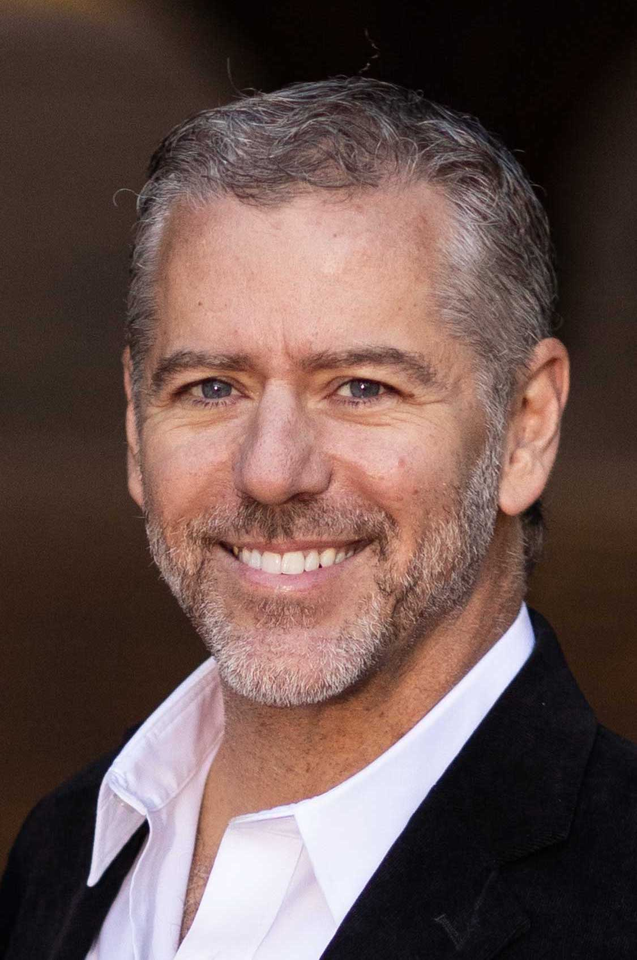
Michael Fortinberry
Senior VP, Perennial Construction
President/Co-Founder, Protiv Inc
Builder, Soldier, Husband, Father, Sailor & Entrepreneur

Slide 4
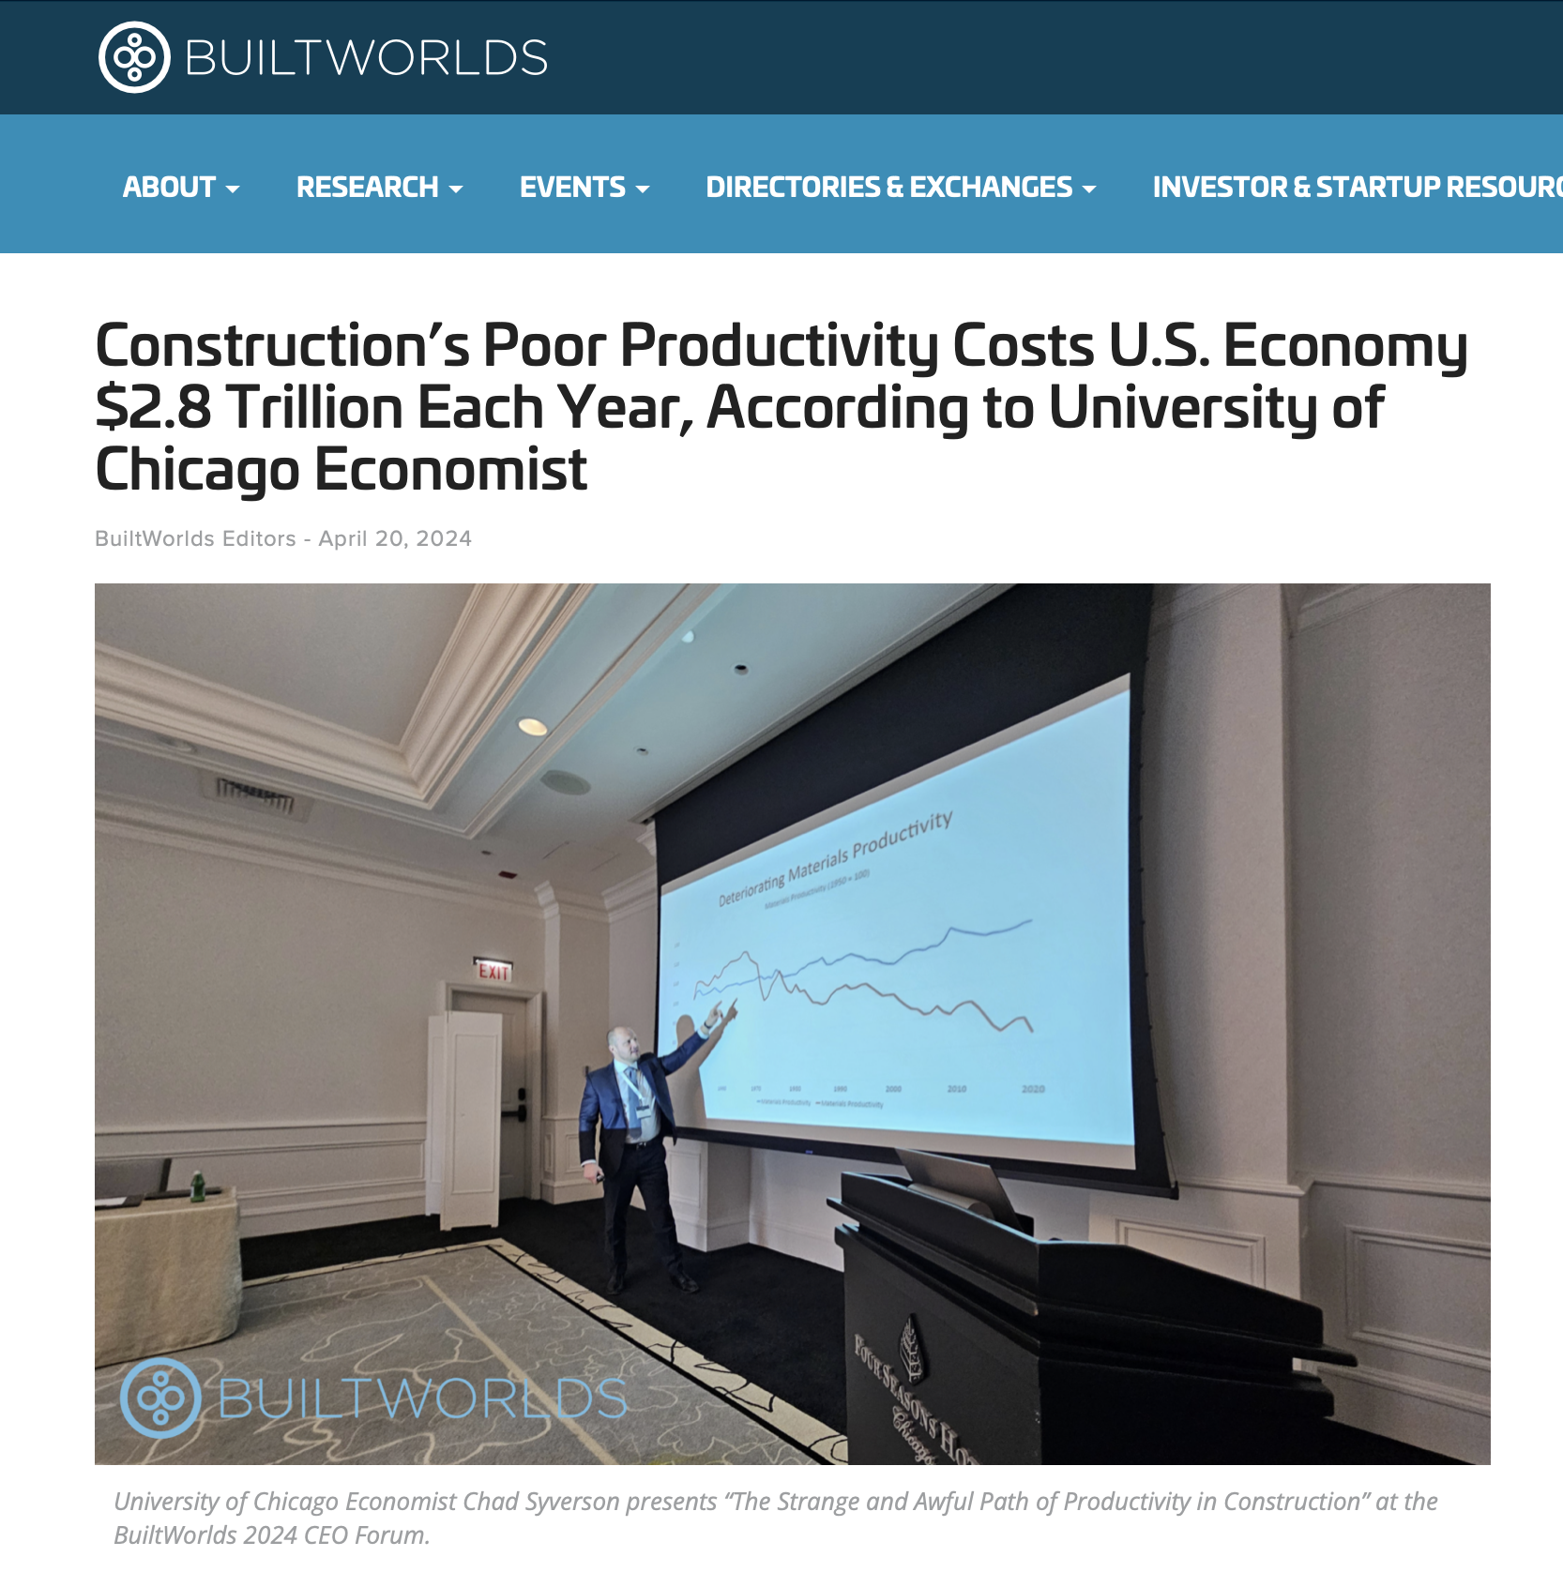
Coincidence? No.
Only 15% of workers in
the construction industry receive employee recognition bonuses*

Slide 5
Lack of incentives is a symptom of an
underlying cause of poor productivity:
Deficiencies in our Company Cultures

Slide 6
What is
Company
Culture?
01

Slide 7
Leadership and Company Culture are what drive business growth

Slide 8
Strong Culture Attracts Better Workers:
More than 75% of job seekers consider a company’s culture before applying for a job with them.
56% of respondents said culture is more important than salary.
-Glassdoor, 2019

Slide 9
“
62% of workers who want to quit, name
“toxic culture” as the primary reason.
-FlexJobs, 2022 Survey

Slide 10
Leaders,
your workers matter the most
to the bottom line

Slide 11
“
You take care of the people. The people take care of the service.
The service takes care of the customer.
The customer takes care of the profit.
-Tom Peters

Slide 12
Four Foundations
to a Strong
Company Culture
02

Slide 13
Four Foundations of Company Culture
Authenticity
People-First
Leadership
Bi-Directional Communication
Growth for All

Slide 14
How Tall Will Your Building Be?
Growth
Communication
People-First
Authenticity

Slide 15
Authenticity
Being honest and transparent about
who you are as a leader, and who
you are as a company.

Slide 16
Authenticity in Practice
Authentic leadership ensures the reality of your company culture matches up with the marketing message about your culture.
Authenticity isn’t about speaking in platitudes.
Get specific about who you want to be and put it into action.

Slide 17
Get to Work!
“You aren’t being paid to believe in the power of your dreams.”

Slide 18
Authenticity Challenges
01
02
03
On a job, if it is a question or “right” or “on-time”, would your team know what you want them to do?
Is it more important a worker gets to his kid’s ball game, or that you finish the job on schedule for customer?
If customer is not happy, but a worker can spend your money to fix it, what would they do?

Slide 19
How Tall Will Your Building Be?
Growth
Communication
People-First Leadership
Authenticity

Slide 20
People-First
Investing in your workers’ well-being, beyond just safety protocols
and platitudes.

Slide 21
People-First in Practice
Your leadership team actually cares about the wellness, safety, and happiness of your workers, beyond business goals.
You actively invest in professional and personal aspects of your workers’ lives.
You are willing for a job to go over schedule to maintain safety standards.
Your workers feel personally valued.

Slide 22
“
Employees who strongly agree their employer cares about their overall well-being are 69% less likely to search for a new job and 36% more likely to be thriving in their overall lives.
-Gallup Report, 2022

Slide 23
Starter Questions
01
02
03
Do you invest the proper focus, time and money into
safety training?
Do you or your managers know the workers’ families and lives?
Do your workers feel leadership is here to help them both personally and professionally?

Slide 24
How Tall Will Your Building Be?
Growth
Communication
People-First Leadership
Authenticity

Slide 25
Communication
Setting the right expectations, communication practices, and
cadences at scale, evolving as the company grows.

Slide 26
Communication in Practice
You have created consistent, scalable communication across all teams.
Teams are empowered to communicate what they need to win.
Management gets accurate information in a timely manner.

Slide 27
Wisdom comes from a lifetime of listening.
Ernest Hemingway
The biggest problem in communication is the illusion that it has taken place.
George Bernard Shaw

Slide 28
Starter Questions
01
02
03
Does your team communicate all their
needs and concerns?
Are your regular team meetings productive,
with an agenda?
How transparent is
your business?

Slide 29
How Tall Will Your Building Be?
Growth
Communication
People-First
Leadership Authenticity

Slide 30
Growth
Understanding what is valuable to individual team members and keep them on their desired trajectory.

Slide 31
If you help enough people
to get what they want,
you can get anything you want.

Slide 32
Growth in Practice
You understand how your employees want to grow their careers or work-life balance.
You know that the personal growth of your employees leads to the growth of your business.

Slide 33
College grads are joining construction industry to be “AI immune”… This is a generation that cares about work-life balance and advancement

Slide 34
Starter Questions
01
02
03
Do your employees want to advance their careers?
Do your employees
want a specific type of work-life balance?
How will you help
them get there?

Slide 35
The Impact of Aligned Incentives
With your team pulling in the same direction, with the incentives connected to what matters to each person, what can you accomplish?
Protiv is a powerful way to link your goals to worker level incentives. As part of a company’s culture, this unlocks real impacts to contractor performance.

Slide 36
The Result from Protiv’s First Year
Created
50,139 hours
in added capacity
Average worker increase $8.35/hour
w/o higher labor cost
Produced jobs
12%+
faster

Slide 37
Thank you!

