Slide 1
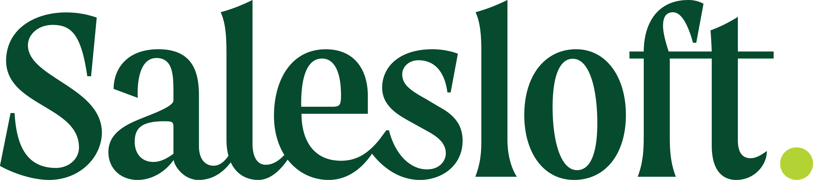
You’re Doing it Wrong!
Top Mistakes You're Making with Your Cadences and How to Fix Them
May 2022

Slide 2
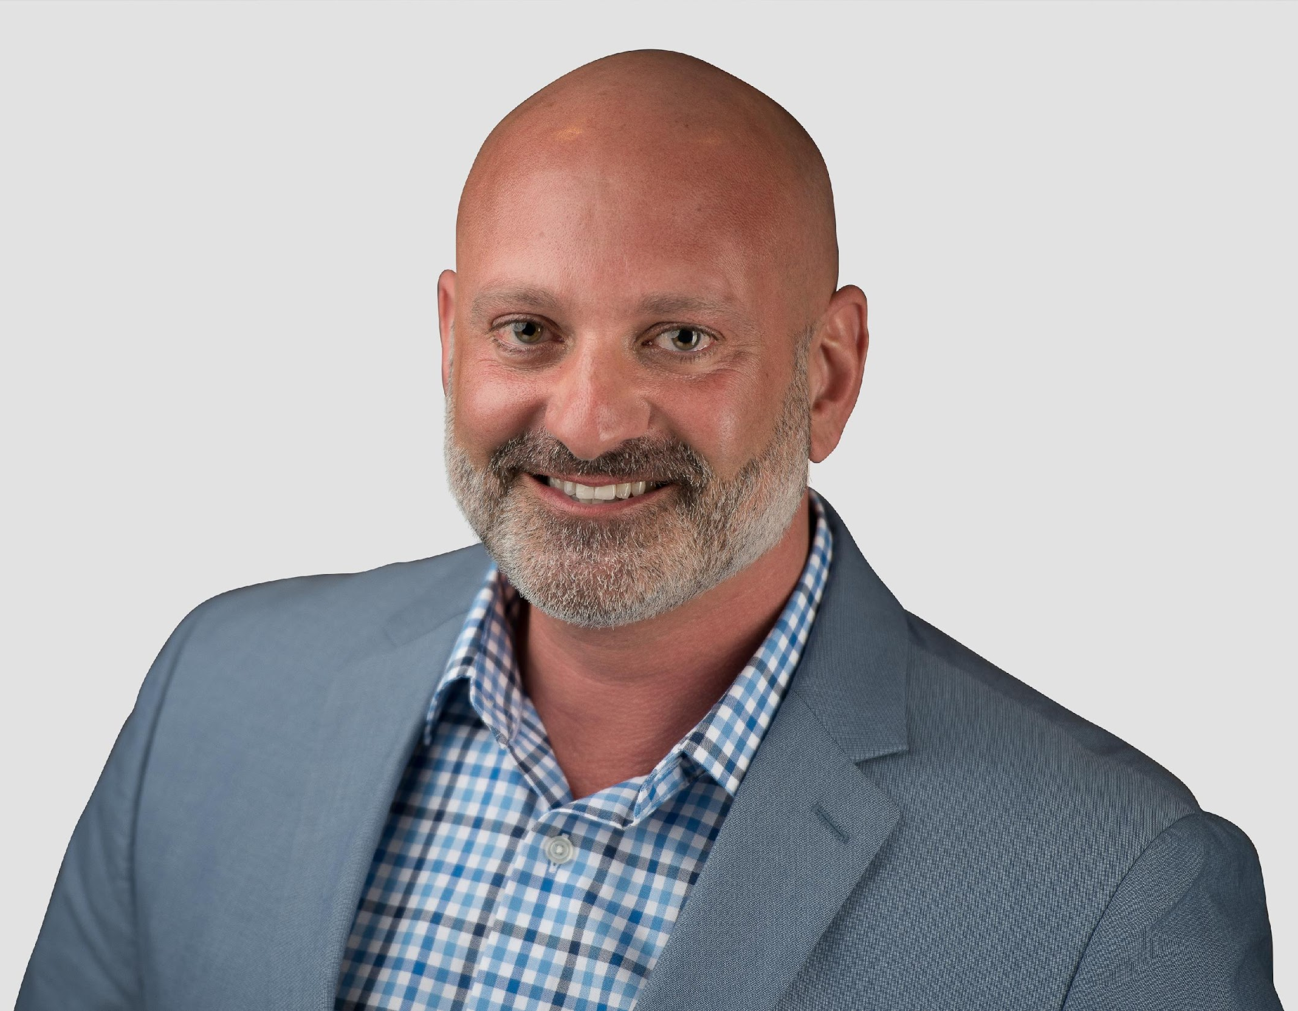
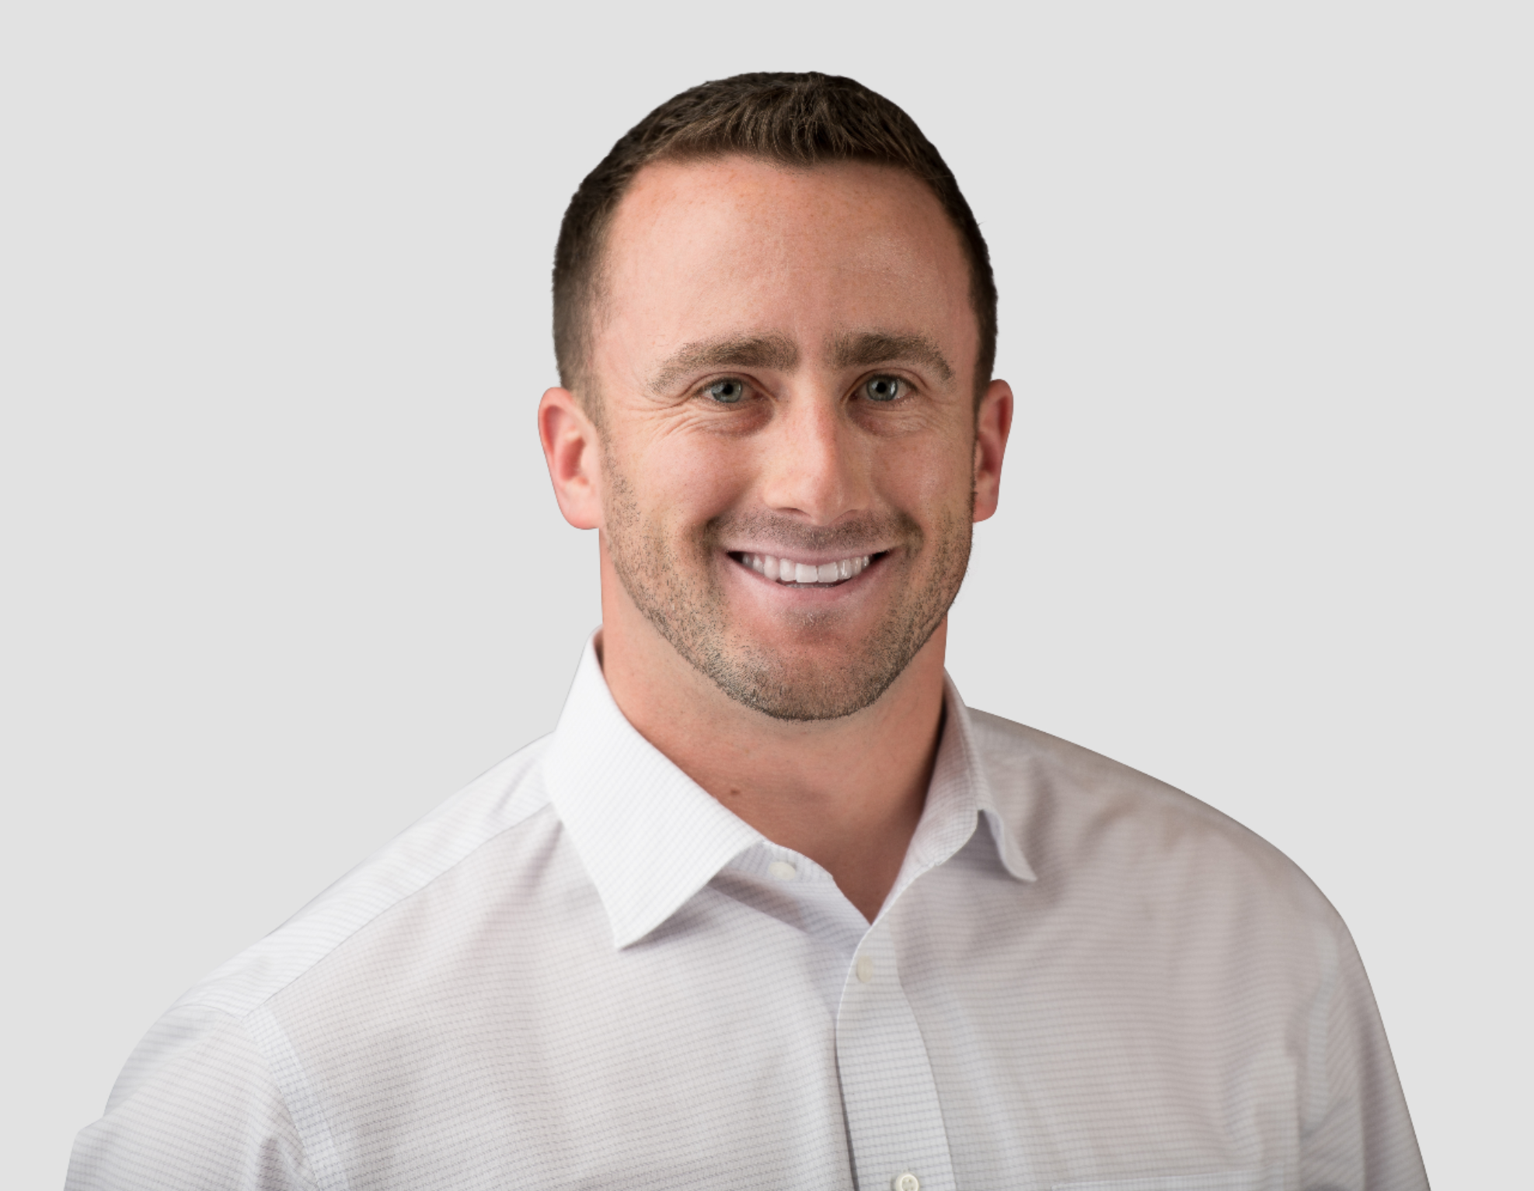
Meet your presenters!
Cadence Consulting Group
Fred Boutros
Founder & CEO
Fred founded CCG after more than 27 years of progressive consulting & sales experience at companies like Accenture, IRI, Nielsen, Trax Retail, MSA and others.
Over the past few decades, Fred developed a deep expertise in both building and leading sales teams and is passionate about CCG's proven Sales Transformation process. Fred holds an MBA from the University of Pittsburgh and a Masters in Engineering from Johns Hopkins University.
Mike LaScola
SVP Sales
Mike brings over a decade of progressive consulting & sales experience to the CCG team. Mike's background and expertise is heavily focused on the CPG industry, where he was responsible for selling and implementing enterprise software and analytic solutions at many of the world's largest CPG manufacturers.
​
Mike holds a Finance degree from Miami University's Farmer School of Business and is passionate about bringing together his finance and analytics expertise to bring new and innovative solutions to the sales process.

Slide 3
Our mission
Accelerate our clients’ revenue growth through sales people, processes & technology

Slide 4
We support our clients throughout the entire sales funnel
Outsourced SDR
9 Meetings
3 Opportunities
1 Closed Deal
Recruit, Hire, Train
Sales Transformation
Sales Playbooks
Generate more leads
Convert leads to opportunities
Convert opps to revenue

Slide 5
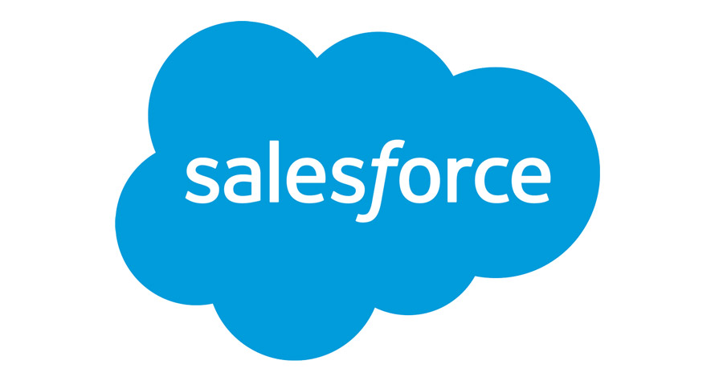
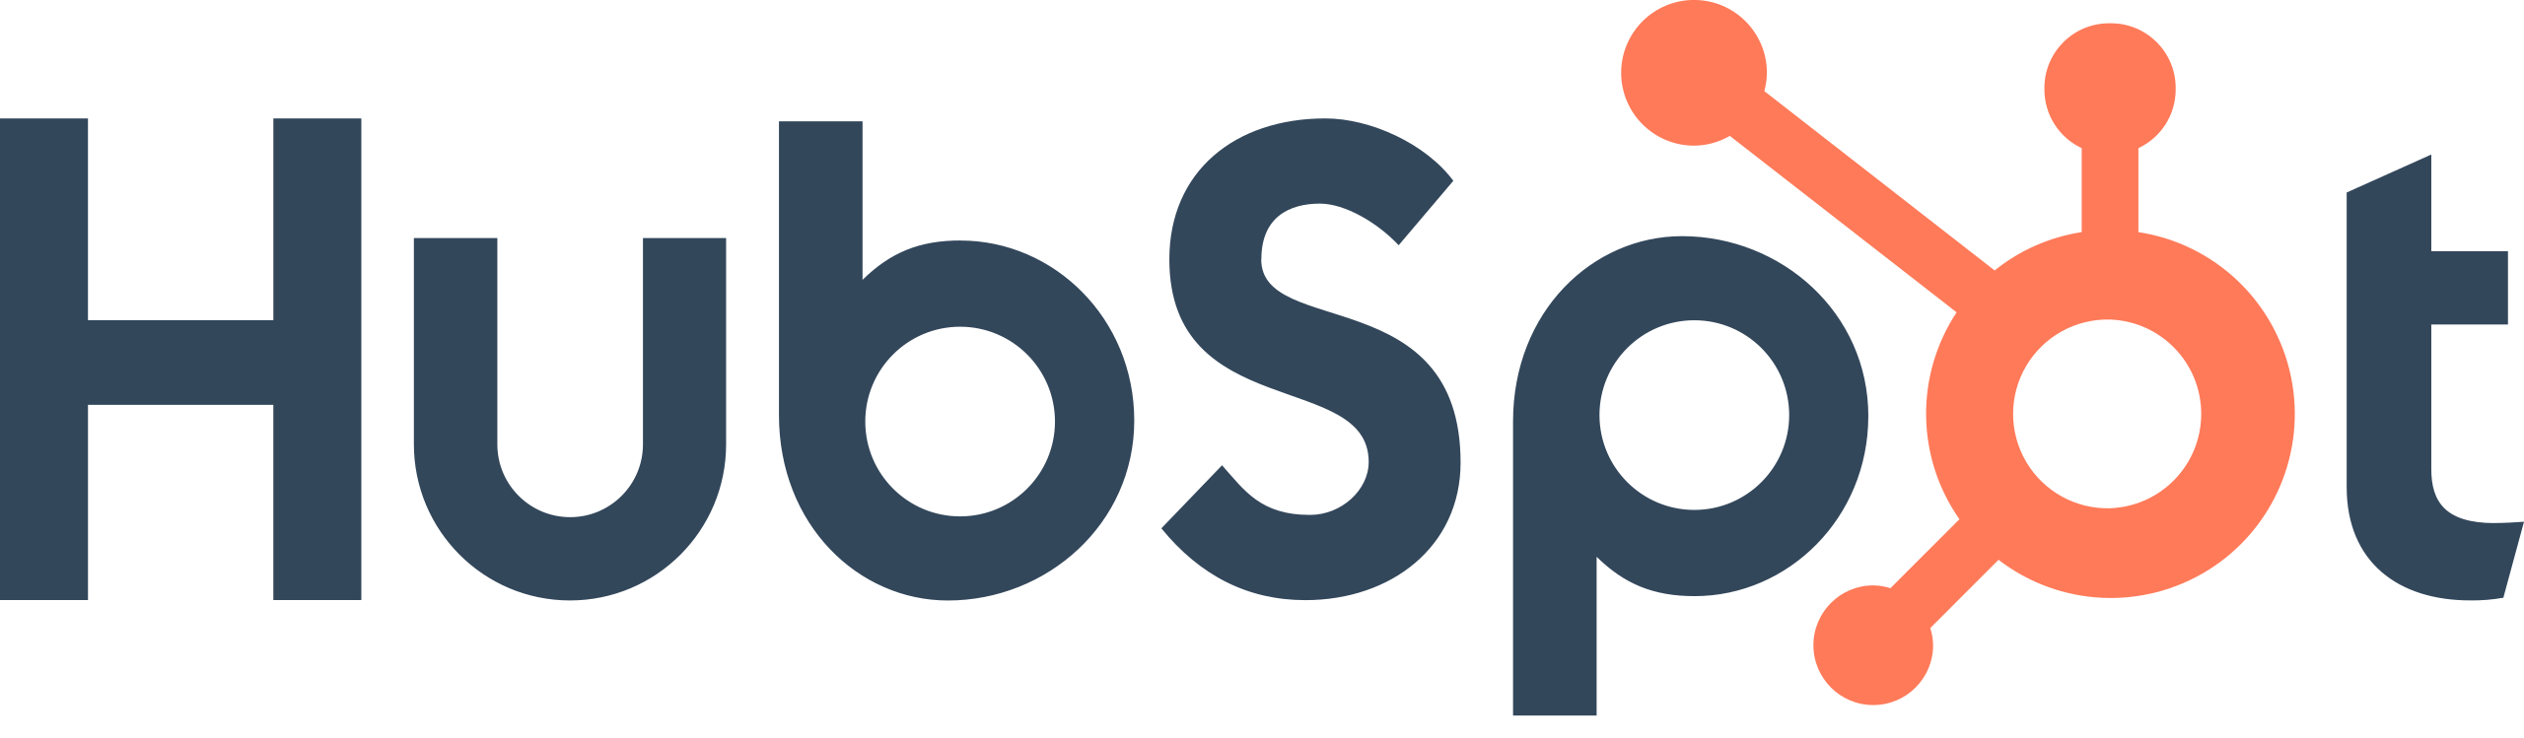
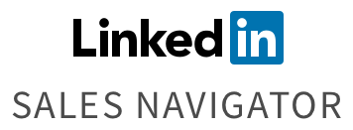
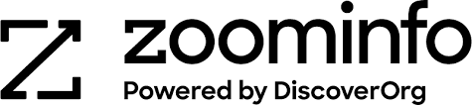
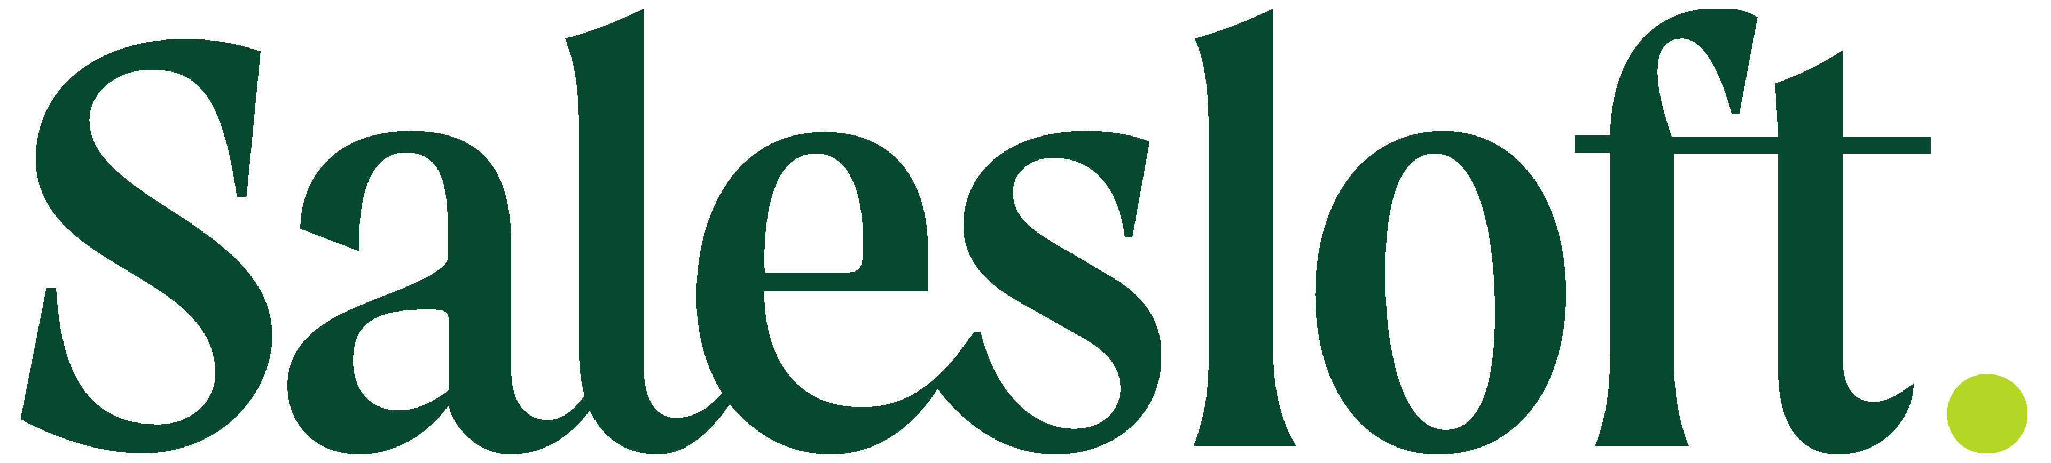
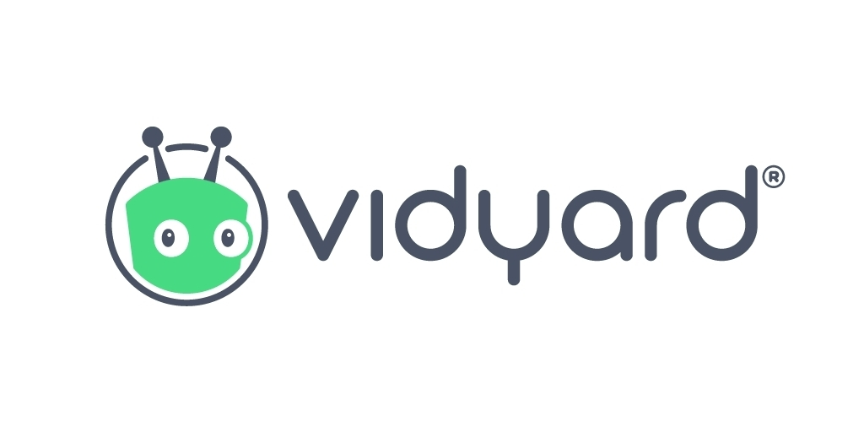
Salesloft is at the heart of our recommended lead generation tech stack
CRM
Prospecting
Contact Database
Sales Engagement
Custom Video

Slide 6
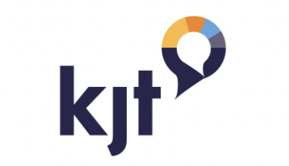
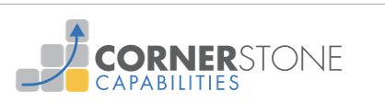

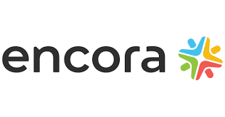

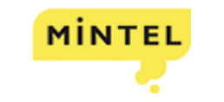

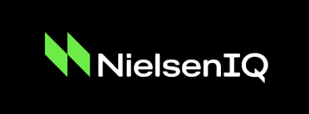
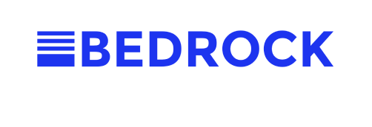

We help clients of all sizes and stages; Ranging from $3M in ARR to $6.5B
Outsourced SDR + recruit/hire/train team
+80% net new meetings
Acquired
Outsourced SDR model
40 Net New Mtgs in first 3 months
325+ Net New Meetings
71% sales vs. YAGO
New Hire Ramp time cut by 60%
Build Lead Gen Team / Implemented Salesloft
+285% increase in outreach effectiveness
+600% new logos
$25M to $50M in 2.5 years
Outsourced head of sales and
lead gen management. Increased deal sizes by 4x to 6x
In 6 months. Driving 450 net new meetings per year, and projected
to increase top line by 2x to 3x in 2022
Built Lead Gen Team
Outsourced Sales

Slide 7
Top 10 Mistakes You're Making with Your Cadences and How to Fix Them

Slide 8
Mistake 1: Pushing data manually vs. pulling automatically
CRM
CCG Tips
If you or your team are finding it is taking entirely too long to get prospects from your contact database to you CRM and to Salesloft …
Utilize existing automation across platforms to save massive time on this step
We recommend 1-to-1 ride alongs to understand your reps’ process and identify opportunities to improve!
Contact Database
Sales Engagement
Fix: Automate this process by mass importing contact info; Identify w/ Ride Alongs

Slide 9
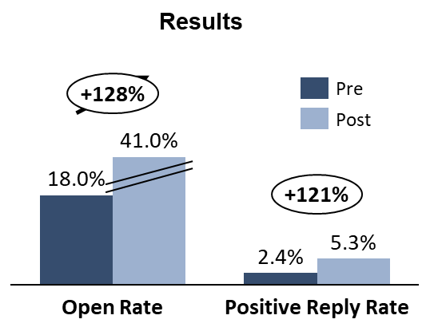
Mistake 2: Use of personal cadences and marketing language
More than 2X increase in cadence effectiveness over an 8-week period
CCG Tips
Sales Language is very direct, focuses on prospects pain & how you can take that pain away, and sounds more like a 1-to-1 communication
Team Cadences allow you to systematically track changes in cadences and understand what’s working and what’s not
From …
To …
Personal cadences
Varied structure
Varied messaging
Varied subject lines
Limited outreach touches
Limited channels of communication
“Marketing” language
Team cadences
Standardized structure
Consistent messaging (80/20)
Optimized subject lines - CTA
14+ outreach touches
4 channels of communication (email, phone, LinkedIn, video)
“Sales” language
Fix: Leverage team cadences with “sales” language

Slide 10
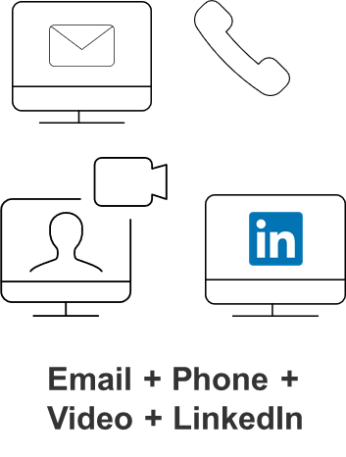
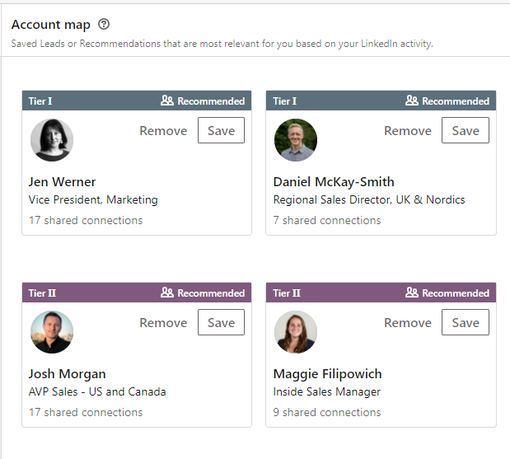
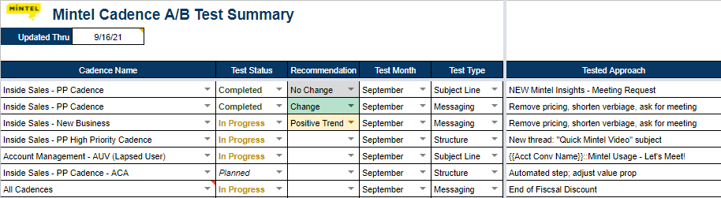
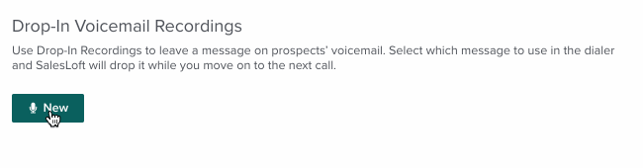
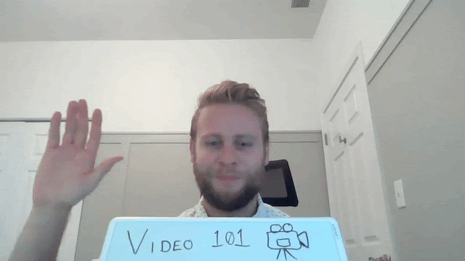
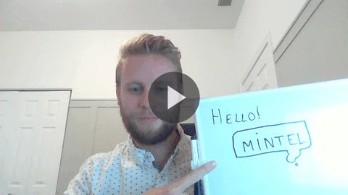
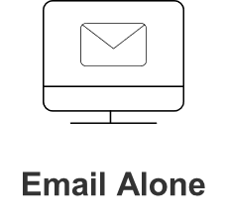
Mistake 3: Only utilizing 1 or 2 channels of communication in your cadences
Email
LinkedIn
CCG Tip
Utilizing 4 channels increases reply rates by +77% to 91%
18X
more effective
than
Phone
Video
Calls Logged 1 Month Ago: 13
Calls Logged Last Week: 553
Fix: Implement (and track) 4 channels of communication in Cadences
10
10

Slide 11
Mistake 4: Not consistently A/B testing or testing multiple changes at once
CCG Tips
A/B tests are arguably the single most important capability within Salesloft
Be sure to consistently test to refresh messaging and stay relevant in the marketplace
Isolate one variable at a time
Here are some thought starters on tests to run …
Subject lines
  Monitor impact to open rates
  Test adding dynamic fields, CTAs, Questions, familiar vs. formal tone, questions, etc.
Email body
  Monitor impact to reply rates
  Short vs. long, value add vs. challenger, aggressive vs. passive, industry specific vs. generic, data driven, casual vs. formal, include/exclude pricing, etc.
Cadence structure
  Monitor impact to both open and reply rates
  Toggle on/off an entire step, automate vs. manual, new thread vs. threaded
  Note: Be careful if trying to test the order of steps within a cadence via an A/B test. Typically best practice is to test this via a separate cadence load as it can be difficult to manage contacts through the steps
Attachments
  Monitor impact to both open and reply rates
  Include/exclude attachments, include/exclude links, include/exclude videos, longer attachments vs. one pagers, value add vs. capabilities
Fix: Consistently A/B test, isolating a single variable to clearly understand impact
11

Slide 12
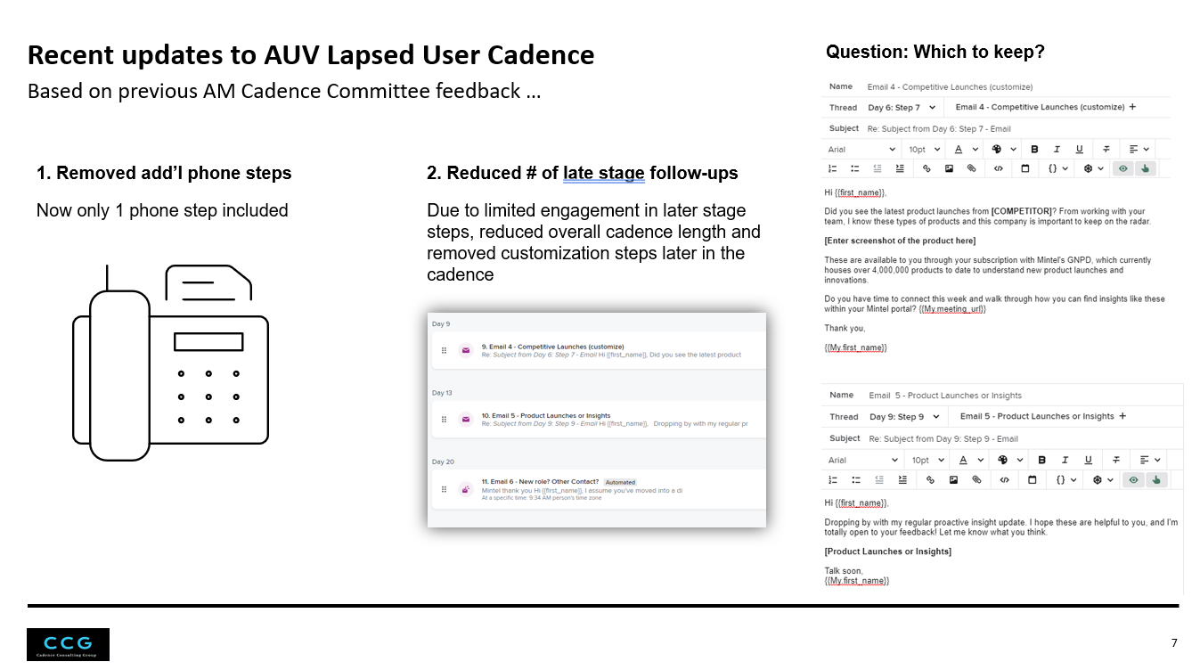
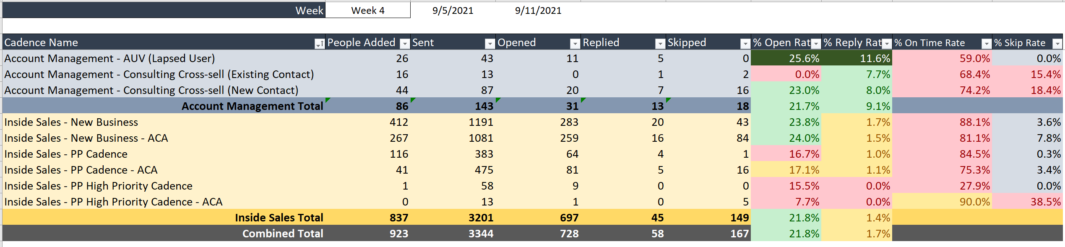
Mistake 5: No standardized cadence review process
The purpose of the cadence committee is to address any outstanding concerns, trends, or areas for improvement within the existing team cadence ecosystem in an effort to increase adoption and effectiveness of outreach
CCG Tips
Include sales managers AND account reps in the committee
No more than 5 committee members (they can rotate)
Make sure you meet at least monthly
Review cadence
activity & performance
Highlight A/B test results
& cadence updates
Plan future
enhancements
Review cadence KPIs with the team
Identify areas that are working well
Identify steps that you want to A/B test
Align on A/B tests to put into place
Review current A/B tests in market
Highlight any changes that are recommended as a result of these tests
Collect team feedback
Share ride-along feedback & findings
Align on new cadence launches and priorities
Fix: Implement structure & process via a cadence committee
12
12

Slide 13


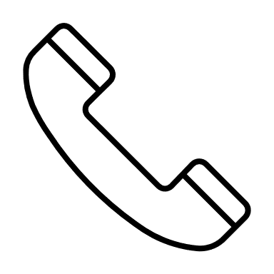
Mistake 6: Not adding new contacts to your cadence every day
CCG Tips
Countless reps call out the pain of having to complete too many steps on a given day (i.e. phone calls)
This is often a result of batch loading contacts to a cadence
It’s essential to set a daily pace and stick to it to make sure you are completing all steps on time and maximizing your chances of success
Example Daily Pacing
20+
New Contacts
per day
30+
Emails
per day
10+
Phone Calls
per day
Fix: Set & execute against daily targets for new contacts, emails, calls
13
13

Slide 14
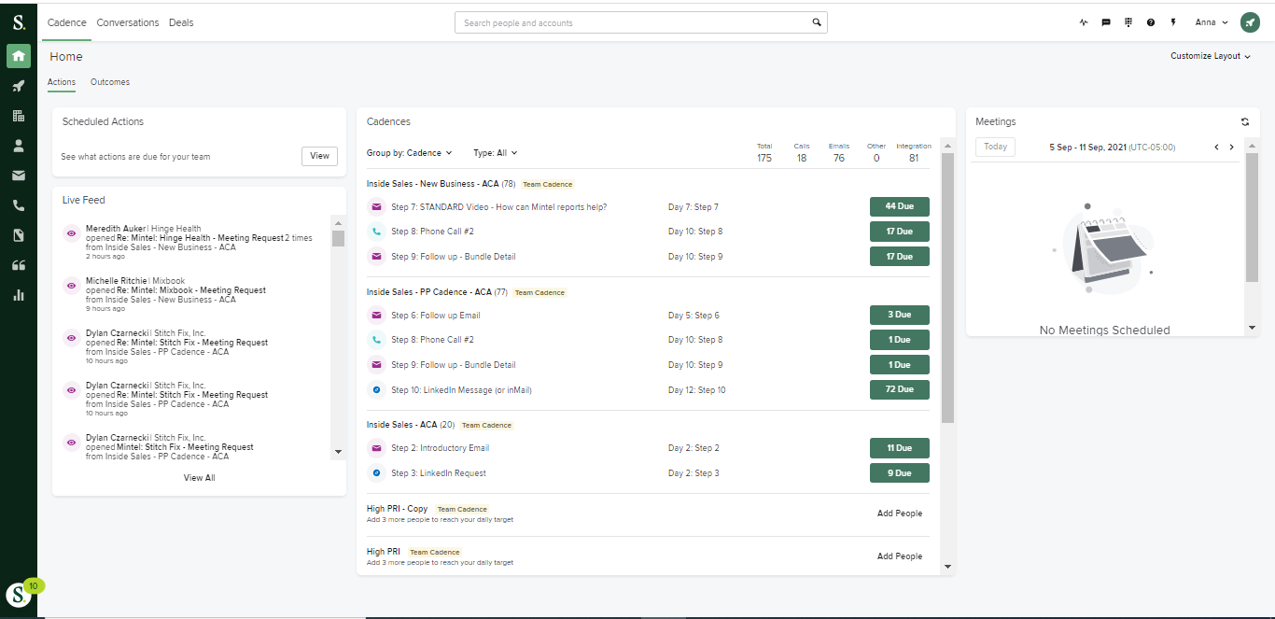
Mistake 7: Only sending messages when cadence says it’s time
CCG Tips
We teach our SDRs to “live in the live feed”
Let Salesloft do the work of automating other steps, have your team focus energy on their Hot Leads while their interest is piqued!
We recommend waiting ~1-2 hours after they’ve become a hot lead
We set our Hot Leads threshold to 3+ email opens – check your admin settings to set what makes sense for your business
Fix: Strike while the iron is hot! Utilize live feed for custom emails, videos & calls
14
14

Slide 15
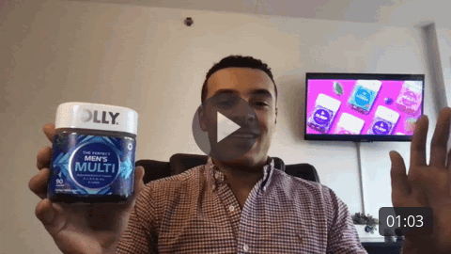
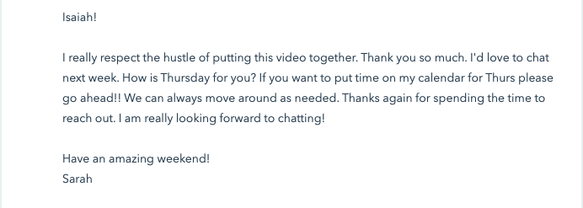
Custom video, product placement, living in the live feed
Mistake 8: Not utilizing custom video effectively
CCG Tips
Be creative & have fun!
We personally love using product placement (see right), personal anecdotes, and white boards to build a custom thumbnail
Keep it brief – we aim for 1 minute or less
No script. The less rehearsed you sound, the better. Be you!
Prioritize based on live feed
Fix: Target your hot leads with custom videos. Have fun with it!

Slide 16
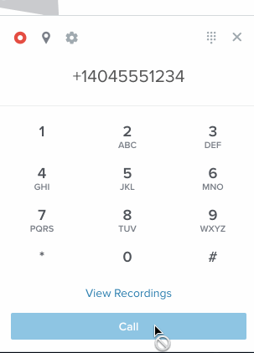
Mistake 9: Losing time by calling all prospects and leaving custom voicemails for each
CCG Tips
By using Salesloft’s dialer, you can save time by leaving a “Drop-in voicemail” recording
Leaving 20 identical voicemails can be exhausting – don’t lose energy. Record your VM first thing in the morning so that your prospects can feel your excitement!
We find it is much more efficient to focus calls and energy on your hot leads (noticing a theme?) – these prospects are already interested and interacting with your messages
Fix: Use the dialer; prioritize your hot leads; record drop-in VMs every morning
16
16

Slide 17
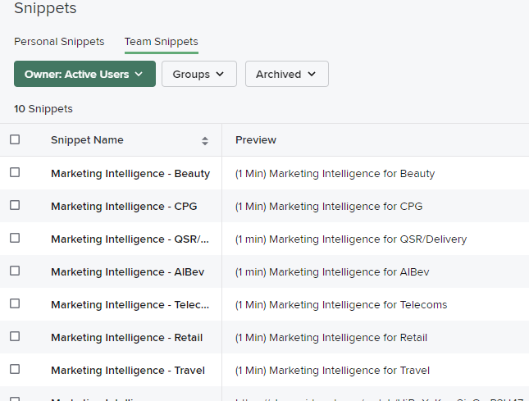
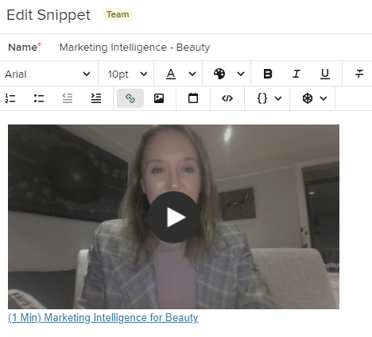
Mistake 10: Spending too much time customizing messaging
CCG Tips
Snippets can be used not only within cadences, but can also be accessed via your email agent – it’s a great way to arm your team with objection handling responses, capabilities and more!
Building a standard list of customization snippets helps guide your team to know exactly what and how to customize their messages
Put a placeholder in your cadences!
Fix: Leverage team snippets to streamline your team’s customization efforts

Slide 18
CCG’s Cadence Best Practices
Automate prospecting & contact management by mass importing contact info; Identify w/ Ride Alongs
Leverage team cadences with “sales” language
Implement (and track) 4 channels of communication in Cadences
Consistently A/B test, isolating a single variable to clearly understand impact
Implement structure & process via a cadence committee
Set & execute against daily targets for new contacts, emails, calls
Strike while the iron is hot! Utilize live feed for custom emails, videos & calls
Target your hot leads with custom videos. Have fun with it!
Use the dialer; prioritize your hot leads; record drop-in VMs every morning
Leverage team snippets to streamline your team’s customization efforts

Slide 19
Questions?
Cadence Consulting Group
Fred Boutros
Founder & CEO
Alfred.boutros@thinkcadence.com
Mike LaScola
SVP Sales
Mike.lascola@thinkcadence.com

Slide 20
Thank you

