Slide 1
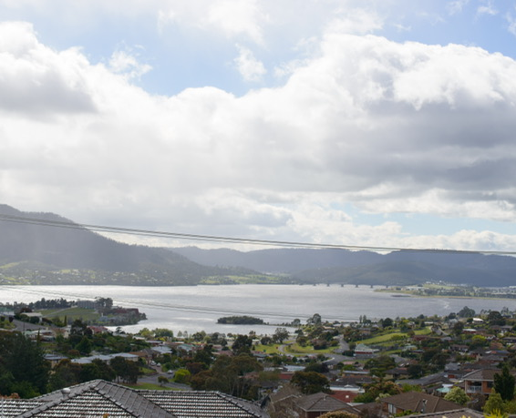

The Talent Initiative

Slide 2
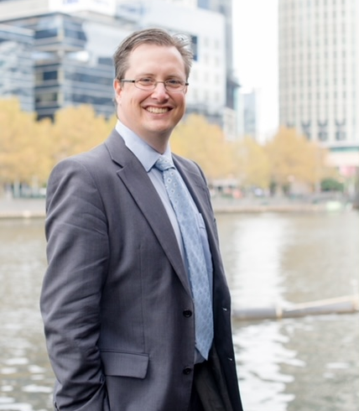
Who are we?
Born out of decades at the forefront of People leadership, The Talent Initiative is a collective of dedicated professionals, brands and companies all focussed on empowering businesses to optimize their Talent Acquisition (TA) and Human Resources (HR) functions.
Our Founder Dan Nuroo, a globally connected leader, has led People functions in corporate environments since the early 2000s. Leading and building teams, nationally and internationally and making them the competitive advantage they should be.
Known as an innovator, he’s excited to bring the Talent Initiative to life.

Slide 3
What do we do?
Our team excels at bridging the gap between business objectives and People strategies, ensuring seamless alignment.
We offer fresh perspectives and innovative thinking to inspire teams to discover new opportunities and elevate their performance.
We proficiently navigate every stage of the employee lifecycle, offering invaluable solutions to address a spectrum of people-related challenges.
Whether servicing enterprise clients or small businesses, we consistently deliver value and resolve issues with precision and expertise.
To break it down beyond Consulting speak.

Slide 4

Talent Acquisition (TA)
From traditional fee-for-resources models to ad hoc assistance, we offer a comprehensive range of talent acquisition solutions.
Whether you’re looking to enhance your talent acquisition capabilities through training and mentorship, develop a robust TA strategy, building deep and active talent pools, conduct a function audit, or simply seek advice and collaboration, we’ve got you covered.

Slide 5

Human Resources (HR)
Empower your organisation to navigate people issues confidently. Rather than depending on untrained managers, unlock the potential of our HR as a Service offering.
We specialise in crafting effective onboarding and induction strategies, managing the entire employment lifecycle, and facilitating seamless offboarding and alumni engagement.
Whether it's organisational change or cultural uplift, we provide comprehensive support with analytics, performance management, reward and recognition, as well as expert guidance on employee and industrial relations
This Photo by Unknown Author is licensed under CC BY-SA

Slide 6

Offboarding
Navigating the departure process, whether voluntary or involuntary, can be challenging.
We offer comprehensive support to ease this transition. From conducting impartial exit interviews to providing outplacement services, fostering alumni connections, and facilitating boomerang hires, we’re here to assist you every step of the way.

Slide 7

HR Technical Advice and selection
With a plethora of HR Tech vendors saturating the market, making the right choice can be daunting amidst the array of options.
Our expertise enables us to streamline this process for you. From crafting robust business cases and conducting needs analyses to guiding you in selecting the ideal vendor, we offer comprehensive support.
Leveraging our partnerships for implementation and selection assistance, coupled with strong relationships with numerous vendors, we ensure a seamless and tailored technical solution for your business needs.

Slide 8






Technology Partners

Slide 9

How do we do it?
Our “collective” model allows us to deliver the appropriate expertise at the appropriate time.
Our nearly 30 years of experience in the Australian market has allowed us to build an extensive network of professionals ready to solve your problems.
We aren’t a one solution fixes all problems kind of company. We will work with you and your business to ensure the solution is fit for your purpose.

Slide 10

Why engage us?
Why not? We’re a great bunch of people. Ask us, we’ll tell you! OK, we aim to be easy to work with, with uncomplicated, yet structured ways of working.
Our collective is structured in such a way that allows us to keep overheads low, so we back our pricing structure to be extremely commercially competitive.
We’re realists who continue to hold optimism close to our hearts. We are HR for strategic business advantage not HR for process sake.

Slide 11
Now what?
We’re consultants, let’s talk more.
dan@thetalentinitiative.com.au
0418351545

