Slide 1
Cadence Consulting Group
Accelerating sales growth through people, processes & technology
August 2022

Slide 2
Agenda
Introductions
Business Discussion
CCG Business Overview
Wrap Up and Next Steps

Slide 3
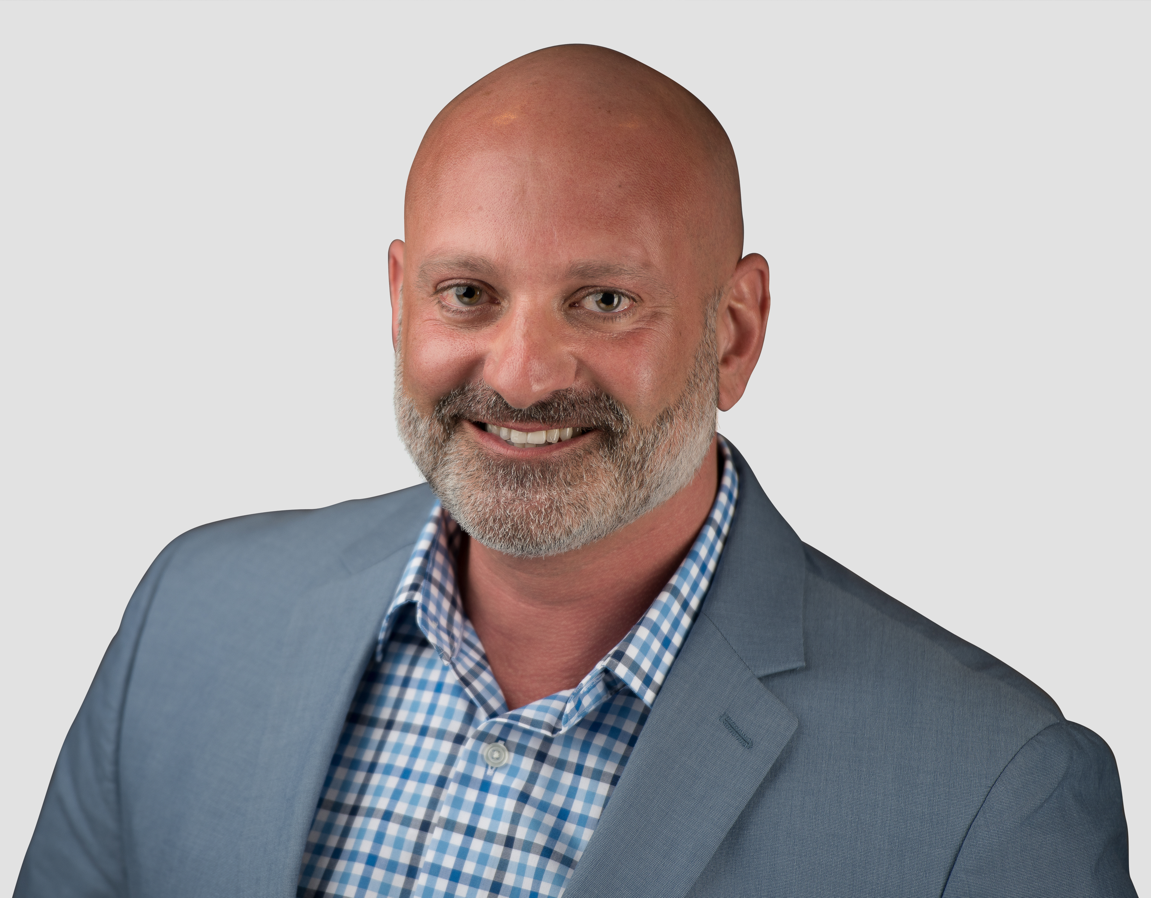
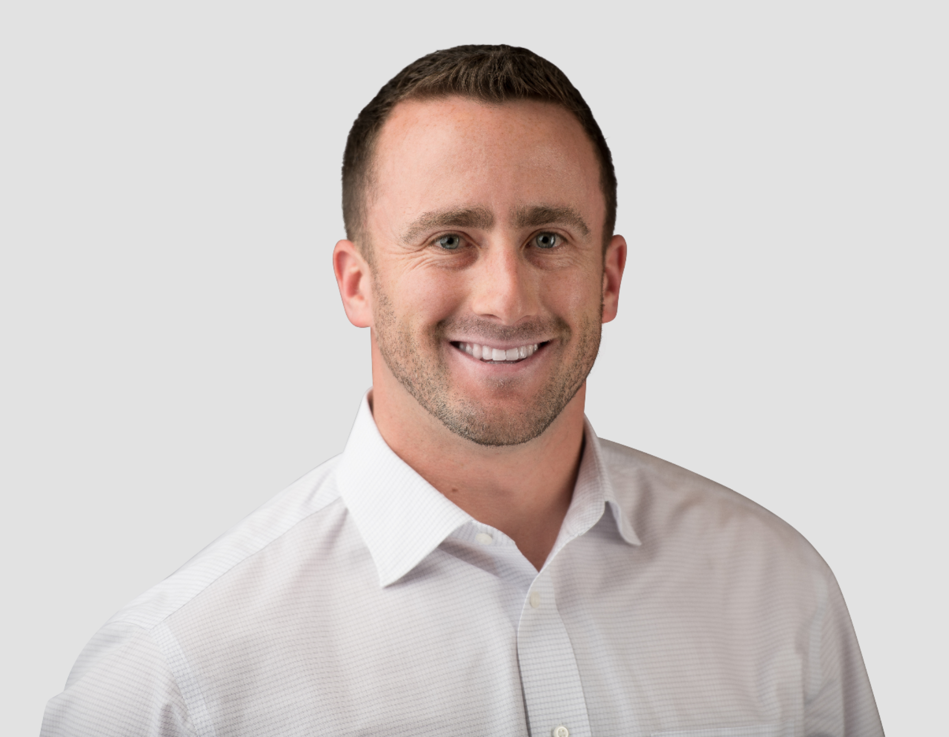
Who is Cadence Consulting Group?
A team of seasoned sales professionals and experienced consultants dedicated to helping sales teams accelerate growth through people, processes and technology
Fred Boutros, President & Founder
30 years of progressive work experience in consulting, sales, sales leadership and sales transformation, working with companies such as Accenture, IRI, Nielsen, MSA and others.
Started CCG to help Private Equity Companies fine tune their tech portfolios
We have a group of seasoned sales professionals from SDRs, to SVPs of sales located across the US, that can help with any and all aspects of the sales cycle and the sales transformation framework. Many of which has worked at companies such as IRI, Nielsen, Double Click and other well-known tech and analytic companies.
Mike LaScola, SVP Sales Transformation
10+ years of progressive work experience at Nielsen in consulting, sales, and sales transformation focused on selling and implementing enterprise software and analytics solutions to Fortune 500, 100 and 50 companies in the CPG industry
Technical expertise in a variety of advanced analytic solutions including revenue management & optimization, assortment & space optimization, matched panel analysis, on shelf availability analysis, store-based audit analysis, consumer behavior analysis and other syndicated data offerings
Proven track record of meeting and exceeding individual & team sales quota leveraging CCG Transformation Framework, increasing average deal size by 250%+, increasing new logos by 3X per year, increasing recognized revenue by 200%+ over a 4-year period

Slide 4




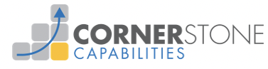


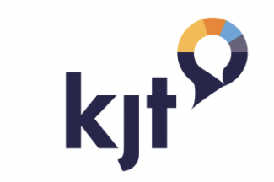

We’ve seen incredible success with this model …
Outsourced head of sales and lead gen
Increased deal sizes by 4x to 9x in 6 months
Driving hundreds of net new meetings per year and increasing revenue by 2x. Completely overhauled sales strategy
+71% sales vs. YAGO (Inside Sales)
New Hire ramp time cut by 60%
Outsourced Head of Sales Enablement
Outsourced SDR model
60 Net New Mtgs in first 4 months
+190% sales in 6 months
+600% new logos
Doubled revenue from $25M to $50M in 2.5 years.
Acquired by NIQ
Built US Market and transformed their go to market strategy and build lead gen team, and help with the acquisition of the company
Building out US Sales Organization including Lead
Generation. Increasing revenue this year by 2x to 3x,
Partnering until they are acquired
Built a high performance Lead Gen team Driving ~650 net new mtgs per year
Outsourced SDR + recruit/hire/train team
+80% net new meetings
Built Lead Gen Team that was driving
300 net new meetings per year

Slide 5
Our Services Have Expanded
Outsourced (AEs)selling and (SDR/BDR) lead generation (we can book meetings and potentially sell also) 1099, or W-2 employees. Teams in the US and Abroad
Sales training, ongoing sales curriculum/certification, and coaching
Financial analytics of sales, revenue, comp plans, territory builds based on revenue achievement;
Implement and fine-turn your Tech Stack including Salesloft, Zoom, Video, etc
Build out cadences and messaging to book the meetings
Build sales and lead generation playbooks
Outsourced Marketing Efforts and Support
We work right beside you like we are part of your organization

Slide 6

CCG’s growth has us better positioned to support you more than ever before!
Larger team, new offerings, more flexibility
Added expertise specific to core competencies at both the SDR and Senior Sales level
Accelerated growth – with current clients, new clients, & new services – 100% retention rate
With a growing network of sales & consulting expertise, we can support in new ways…
Outsourced SDR
Sales/SDR Recruiting, Hiring, Training
Full Sales Transformation
CCG provides named contact to support lead generation efforts
Named contact to send emails, leverage phone, video and LinkedIn to secure meetings for outside sales
Create, standardize and optimize cadence structure and messaging
Creation of monthly cadence committee to review and refine outreach cadences
CCG to recruit and hire required # of AEs/SDRs to meet sales targets
CCG to train Sales/SDRs on lead generation processes and best practices
Build and deliver -specific lead generation playbook
All components included on left portion of page on-demand, plus …
  Sales & GTM strategy development
  Outsourced Sales solutions
  Sales territory building
  Sales comp plan building
  Lead Generation team management
  Implementation of sales enablement software (Salesloft, ZoomInfo, Vidyard, etc.)
  Sales process development & training
  Build and deliver -specific sales playbooks

Slide 7
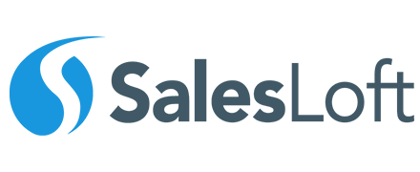

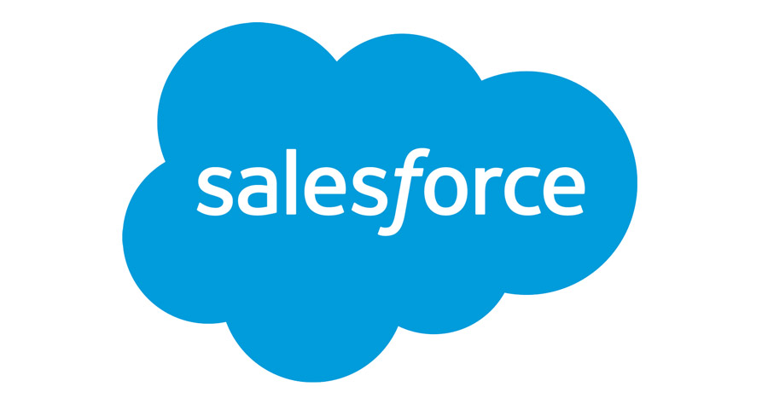
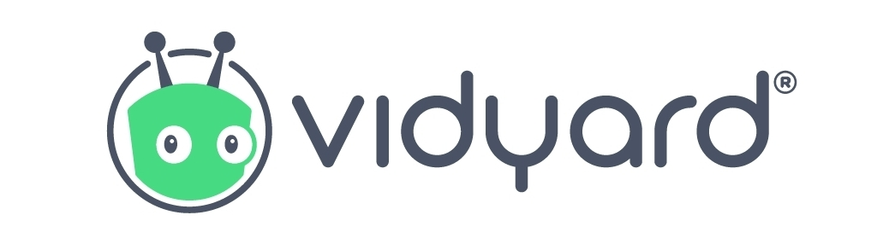
Lead generation technology stack
Sales Enablement
Database for
Contact Information
Customer Relationship Management
Video Tech for
Email Outreach

Slide 8
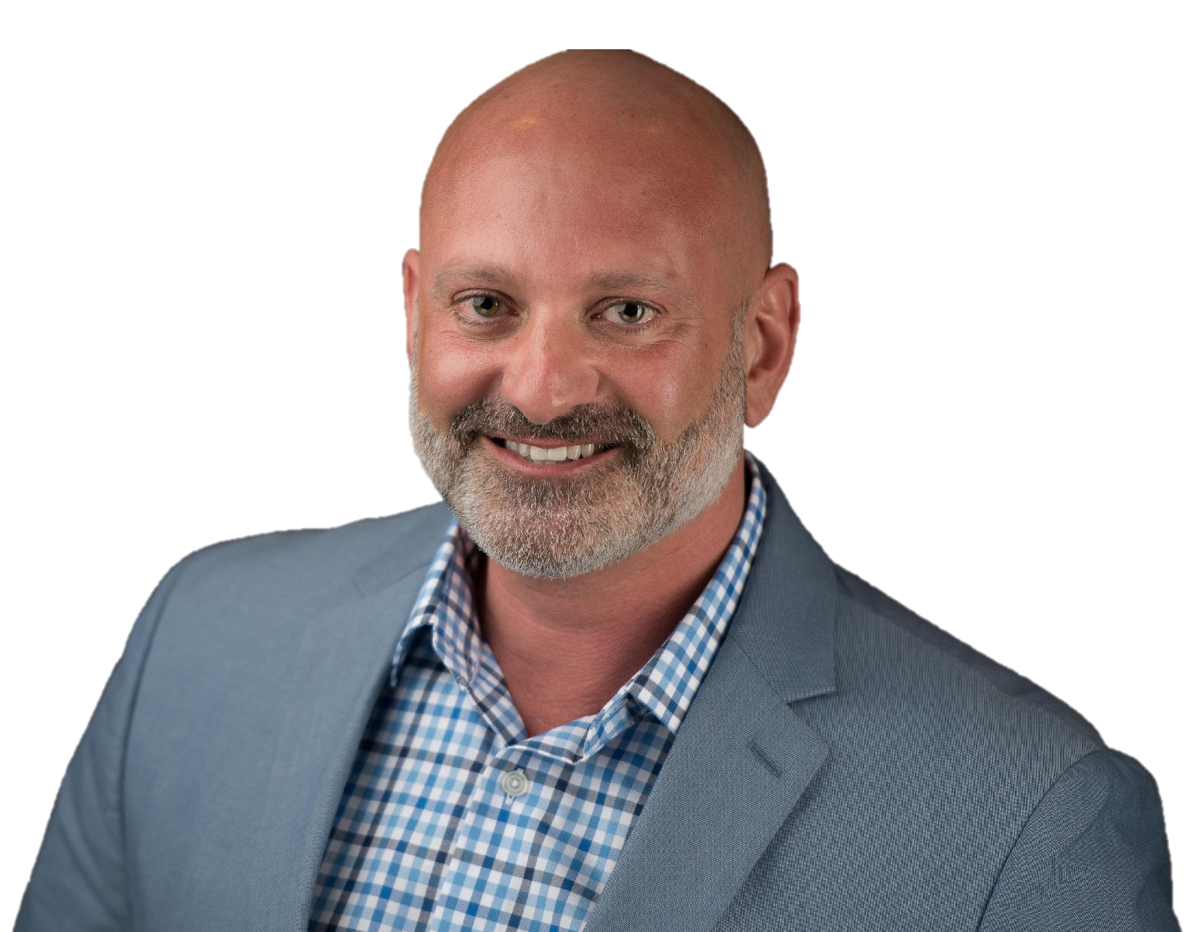
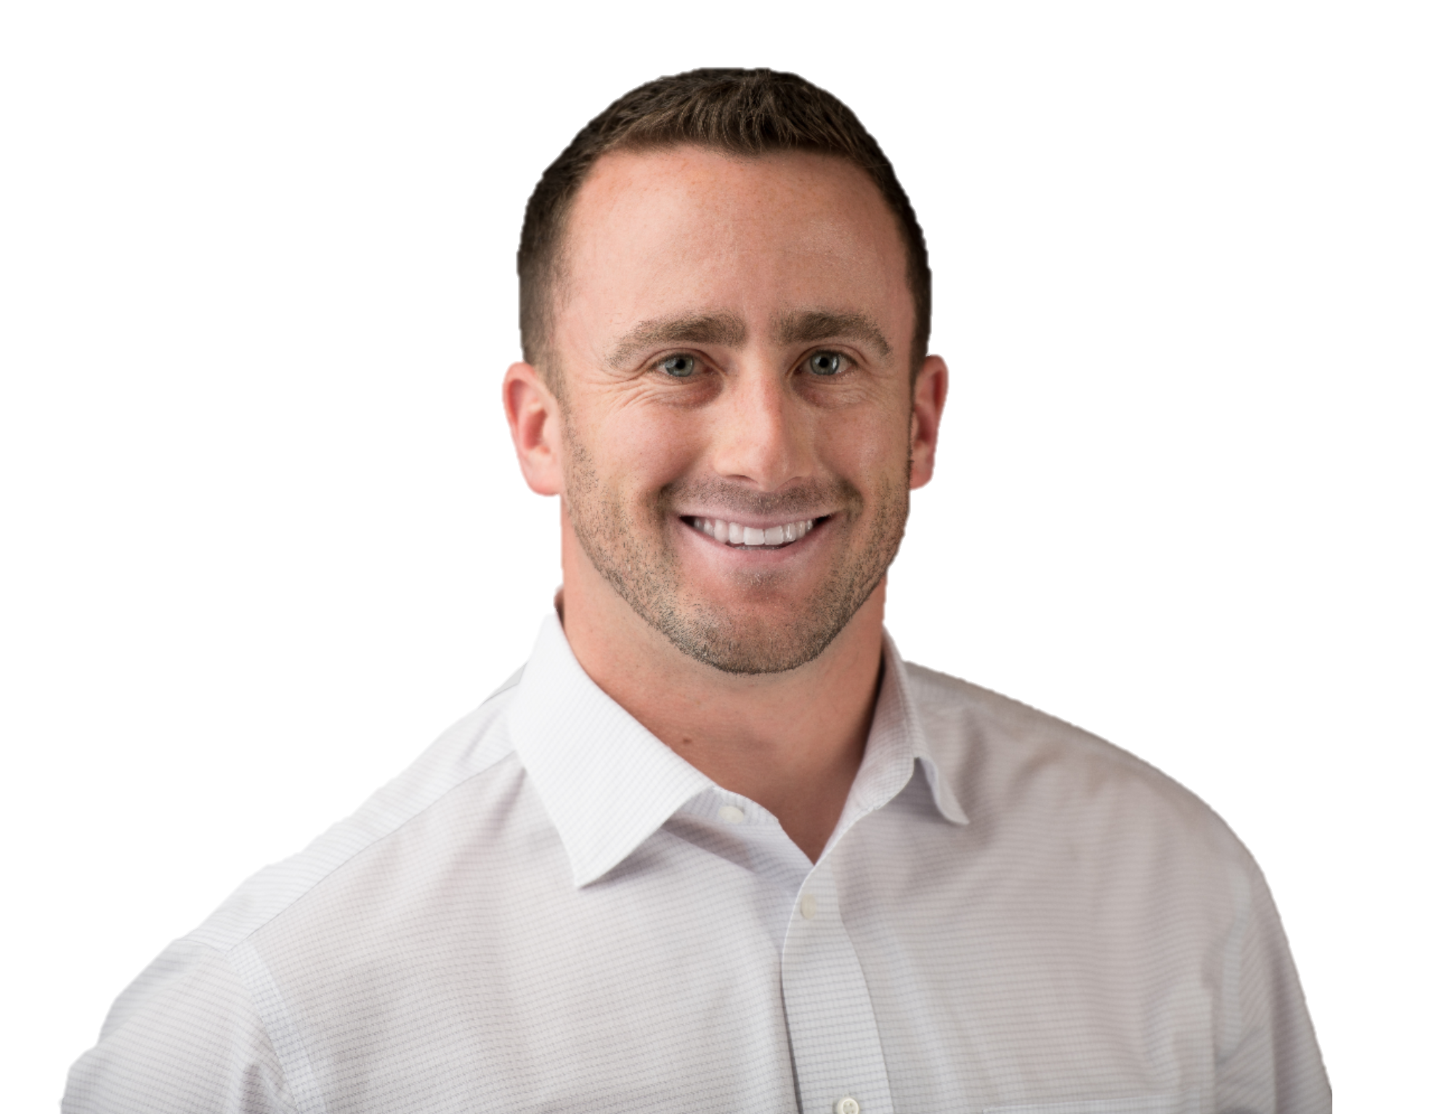
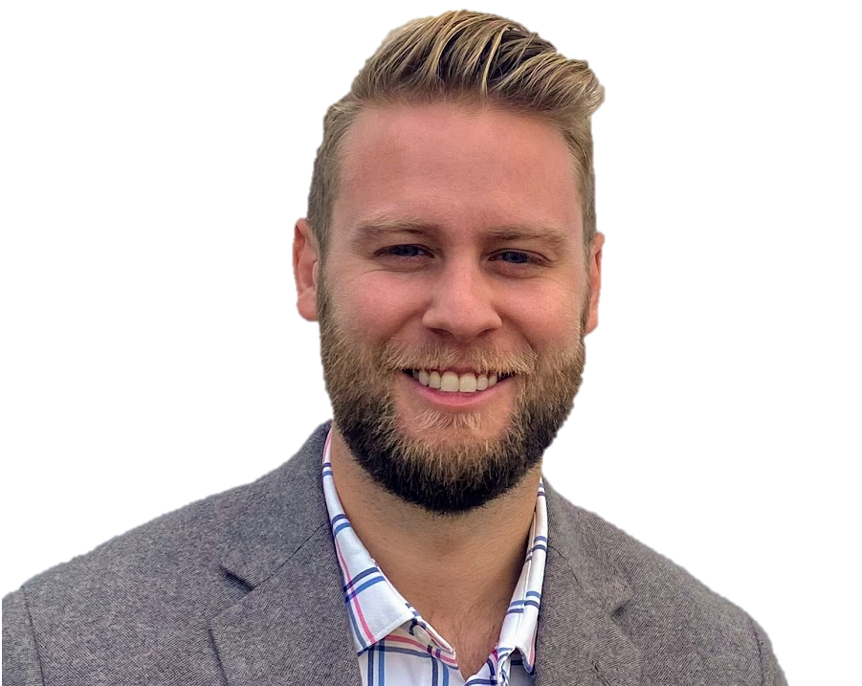
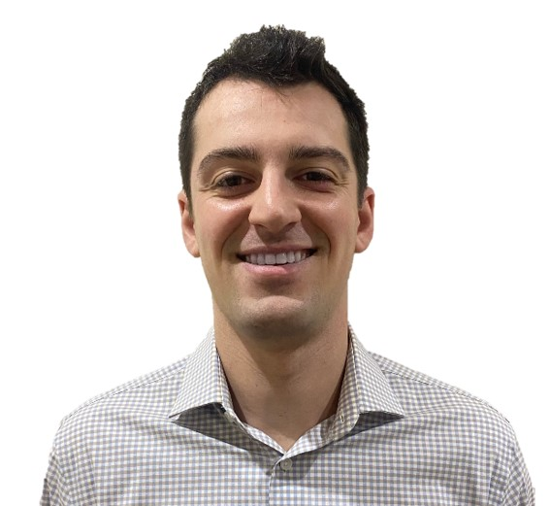
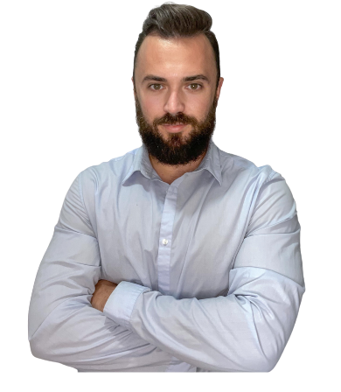
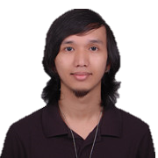
CCG Outsourced SDR Engagement Support Model
Dedicated team of sales experts
Dedicated project manager
Cadence creation
Implementation Lead
Executive Sponsors
Engagement Lead
Primary outreach lead
Procure meetings utilizing 4 Channels of communication
Outreach Lead
10+ Year Sales Experience
Cold calling, cadence creation, social selling via LinkedIn expertise
Primary prospecting lead
Custom research
Account Lists & Lead Lists that meet ICP
SDR Strategy &
Team Lead
Prospecting Lead

Slide 9
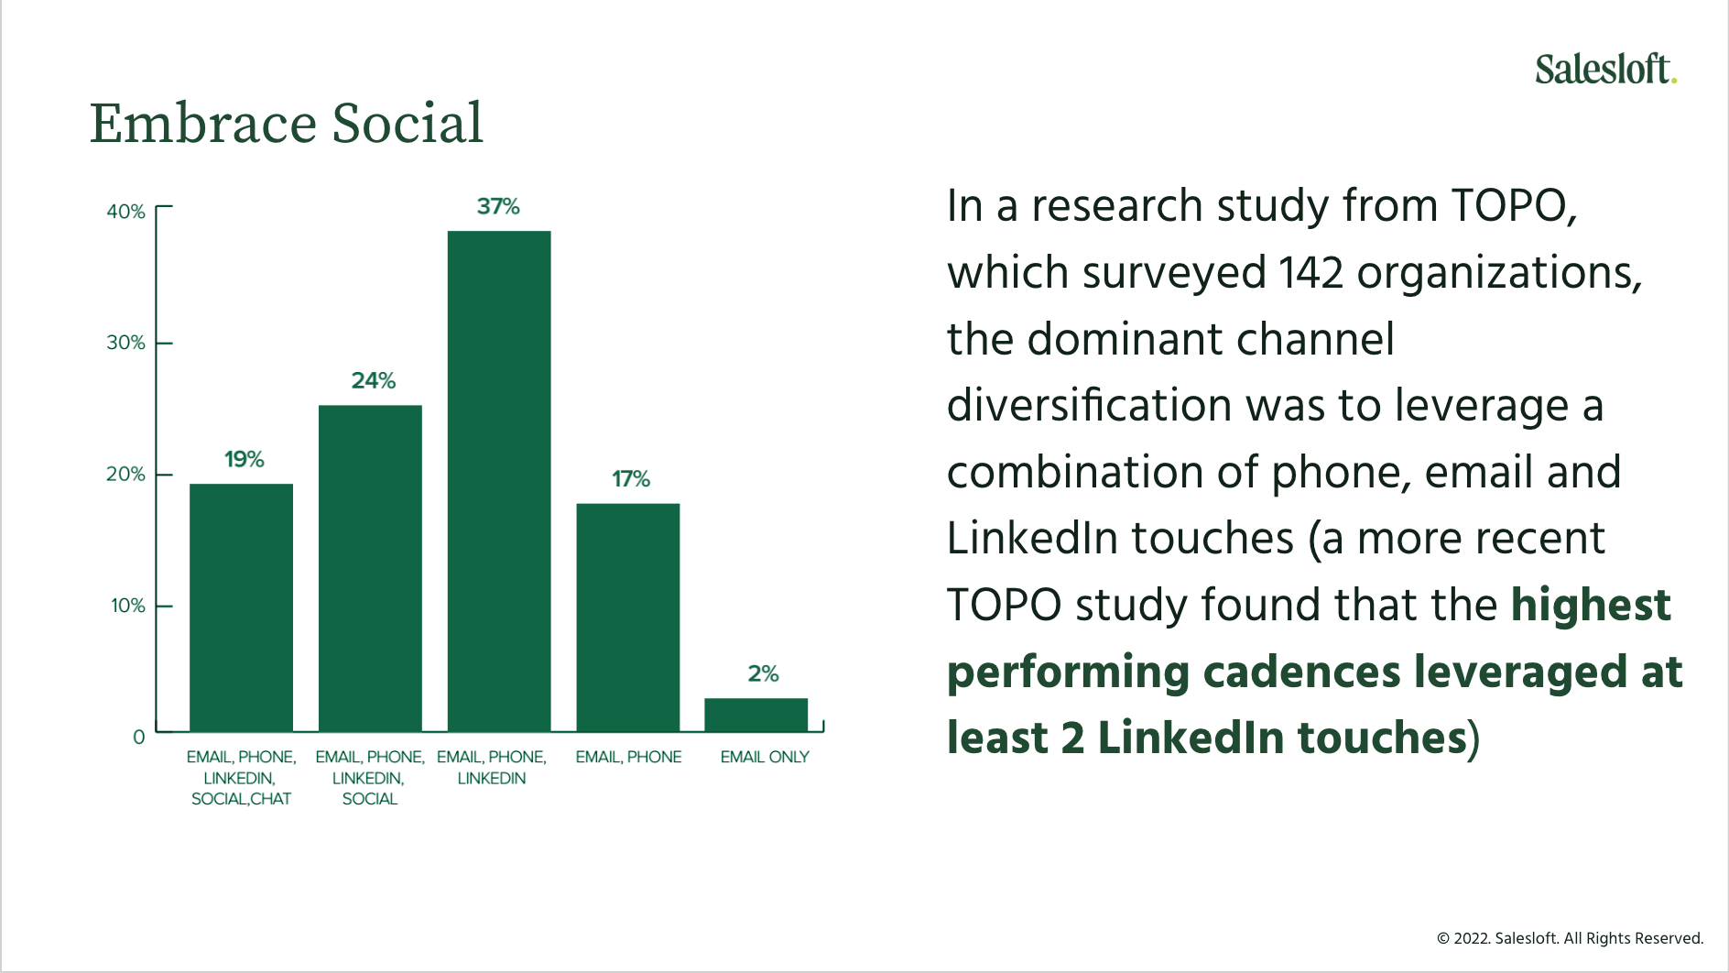

Slide 10
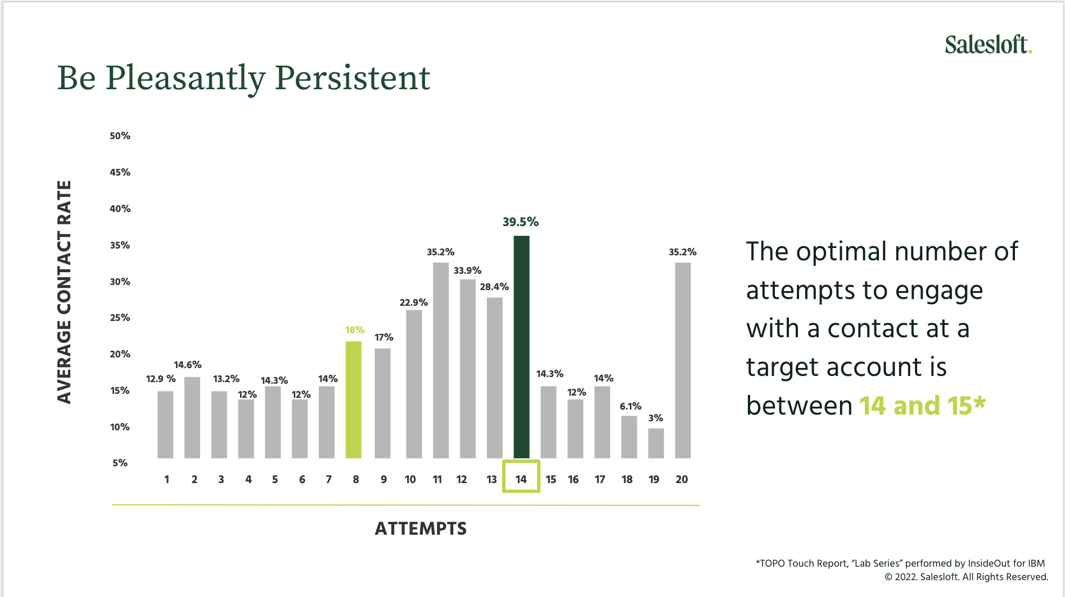

Slide 11
Case Study – Nielsen ‘Sales Effectiveness’
SITUATION
SOLUTION
OUTCOME
Split into sales and delivery
Created outside sales team; hired true sales ‘hunters’ focused 100% on selling
Created lead generation team focused on driving 150 mtgs/rep (over 500/year)
Created new sales process & ROI/value-focused materials (rather than features and functions)
Created a sales engineering team focused on product demos, solution architecture & pricing
At the epicenter of the solution
  Implemented a technology stack to support both inside and outside 3 to 4 channels
  Organized an automated outreach for all within sales
500
new meetings per year
+600%
new clients per year
+50%
increased average deal size
in first 12 months
$25m to $50m
revenue growth in 2.5 years
  ‘Sales’ was a dirty word
  Led with analytics, not with sales
  If you sell it, you deliver it
  Grew accustomed to waiting for the phone to ring, rather than prospecting and selling
  No true salespeople, no real sales training, and no tech stack to support the sales cycle
  Team was only bringing in a total of 8 new clients per year

Slide 12
Financial impact of sales transformation framework
1, 2 and 3 year outlook
Comment about financial impact and multiplier effect by year
2X sales in 3 years

Slide 13
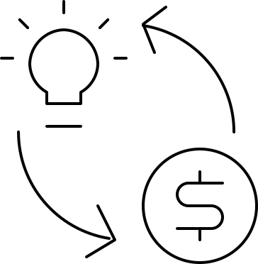
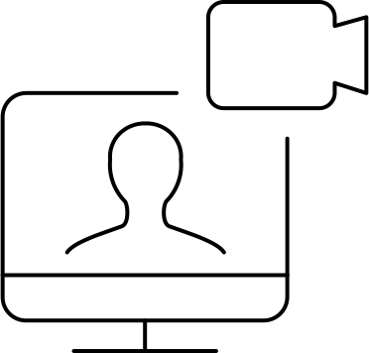
Lead Gen
Primary objective: Accelerate t revenue growth in the US Market
People
Lead Gen Team to support with prospecting, outreach, meeting procurement, and administrative tasks, enabling Outside Sales teams to focus on relationship building, pitching, negotiating and closing
Process
Fuel Pipeline by Generating at least 150 Net New Meetings per SDR per year
Technology
Streamline & automate business development process with sales enablement technology solutions

Slide 14
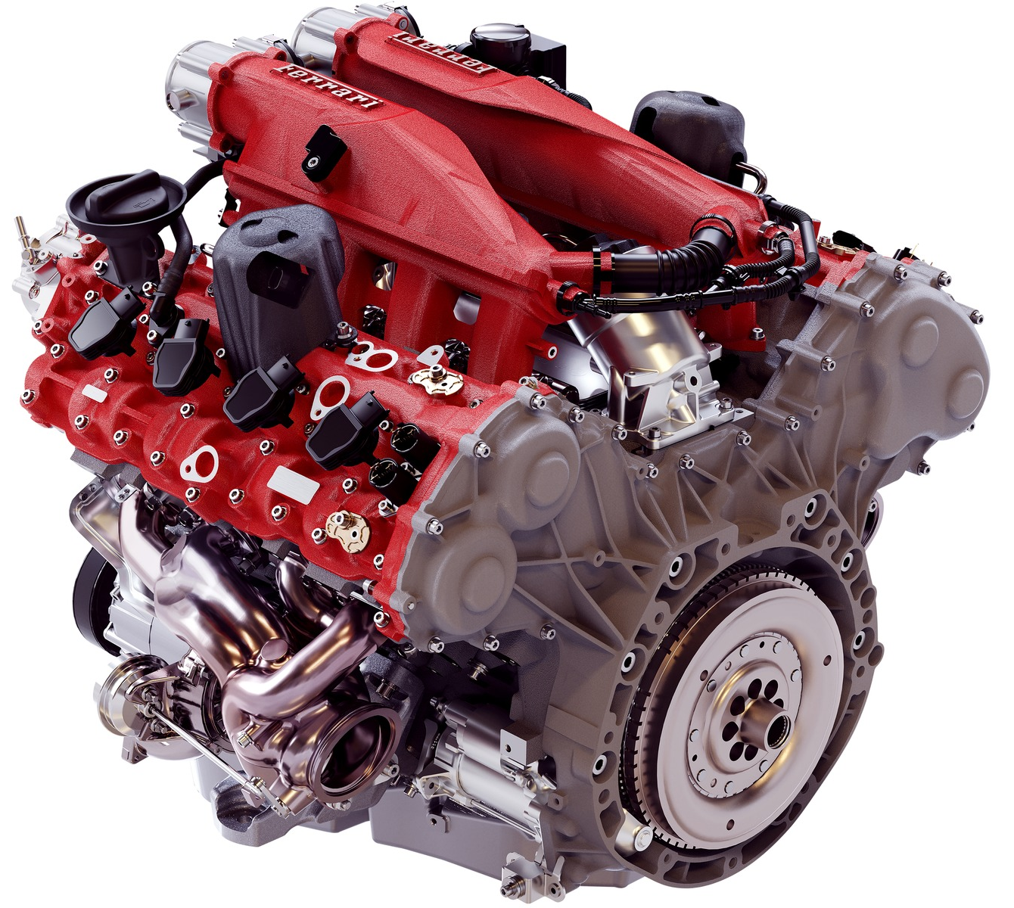
Lead generation team
“The biz dev engine”
Priority Tasks
Prospecting
Outreach
  Email
  Phone
  Video
  Social Media (LinkedIn)
Cadence Creation
Meeting Procurement
  Goal >150 mtgs/year per FTE
Send/schedule follow-ups
Potential Tasks
Pricing & rate card
Proposals
Update & maintain salesforce.com opportunities
Additional administrative tasks
Lead Gen Team will be measured on following KPIs…
Meetings per week
Emails/Calls per week
$ Bookings per year
Email open rate
Email response rate
Click Rate (if applicable)

Slide 15


Sales Transformation requires a paradigm shift
Impact of time spent on sales
FROM …
TO …

Slide 16
CCG Sales Transformation Framework
Assess
Marketing
Finance
Product
Client Success
Sales Organization
MQLs
Sales Management
1. Lead
Generation (SDRs)
SQLs
2. Outside
Sales
3. Solutions Architects
4. Sales Ops & Enablement
“The Biz Dev Engine”
People
Process
Technology

Slide 17
3
Next Steps

Slide 18
Thank you
Fred Boutros
President & Founder, CCG
Alfred.boutros@thinkcadence.com
Mike LaScola
SVP Sales Transformation, CCG
Mike.lascola@thinkcadence.com

Slide 19
Lead Generation
Technology

