Slide 1


QSI Integrations for advanced fraud solutions (Afs)

Slide 2
AFS with ITMs – how does it work?
ITM Teller staff receiving check deposits, but they cannot physically handle the actual check
Need real-time check validation solution
Gov’t regs mandate maximum funds holding time. Prone to loss from fake accounts
Extremely difficult to verify DDA account status and other factors with the customer at the window
TrueChecks is built on the historical and ongoing accrual of check fraud and checking account intel from hundreds of financial institutions NATIONWIDE!
TrueChecks gives your tellers an instant-response based upon Reg-CC procedures.
Customers of all sizes report a 6-month ROI making TrueChecks an immediate value-add protecting your assets and giving your tellers peace of mind in their actions.
TrueChecks® provides real-time responses to counterfeit, non-sufficient funds (NSF), closed account, duplicate, and other fraudulent items from over 2500 institutions. DepositCHEK extends the service to include DDA data from many national Tier 1 institutions providing extended and enhanced check-fraud risk.
DepositCHEK can be added at a later date without an update at the ITM. AFS can manage the update with a backend licensing and
TrueChecks® is integrated directly with NCR’s TellerNow and TellerEnterprise ITM platforms beginning with NCR version 6.10.x. Any earlier version will need to update their NCR ITM software.
Process Description
  Item presented at ITM
  Data collected from check by AFS software (MICR line on check)
  Data routed through host and from host to AFS. Includes DepositCHEK data when customer is enrolled for that upgrade
  AFS processes check data internally and returns recommended response to teller

Slide 3
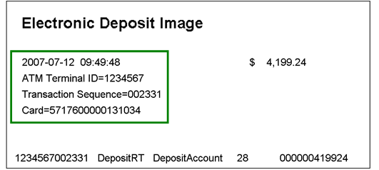
TGaaS (Transaction Gateway as a Service) with QSI’s Check Review Software
The QSI Transaction Gateway as a Service (TGaaS) solution provides the financial institution with a QSI-hosted offering that manages all of the server-side technology in a secure environment.
The solution deliverables are:
Receives the XML files and the associated images from the ATMs, ITMs or Interactive Banker solutions
Environment setup for redundancy and High Availability
Supports File transmission for Item Processing via SFTP
Deposit Review Software platform to:
  Tellers/Accounting can Approve or Reject checks for processing
  Tellers/Accounting can correct MICR line or amount information on incoming deposits
  Tellers/Accounting can view checks prior to hard posting to customers accounts
  * AFS Integration to this platform is available*

